Slide 1
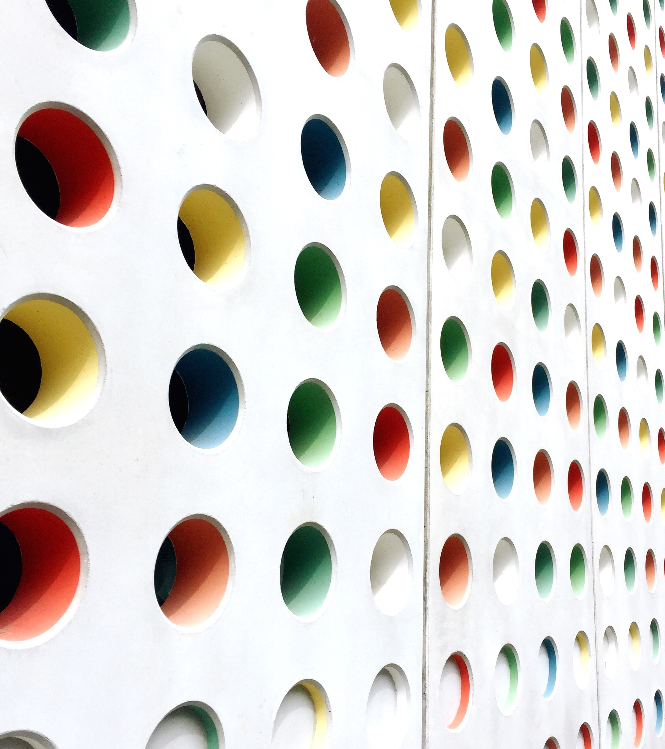
Edge Chip Detection
By BEST FAUlts

Slide 2
Algorithm Outline
Reference Shape Generation
Contour Generation
Noise Removal
Calculation of Edge Attributes
Detection of Edge Vertices

Slide 3

Input Image

Slide 4
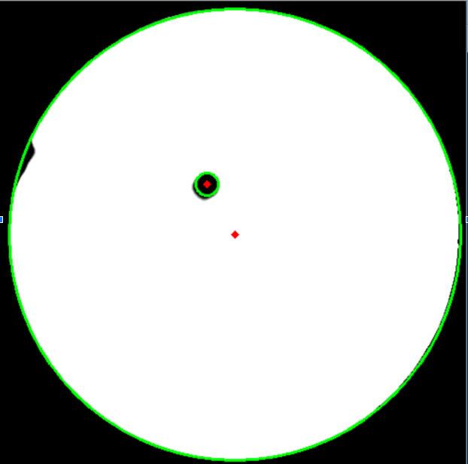
Reference Shape Generation
Method
Circle Hough Transform
Deep Learning
Using Gradient

Slide 5
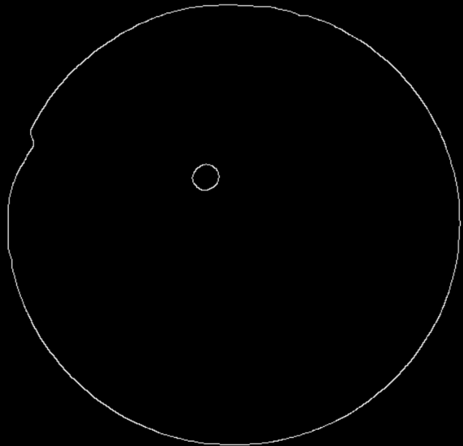
Contour Generation
Method
Canny Edges Algorithm

Slide 6
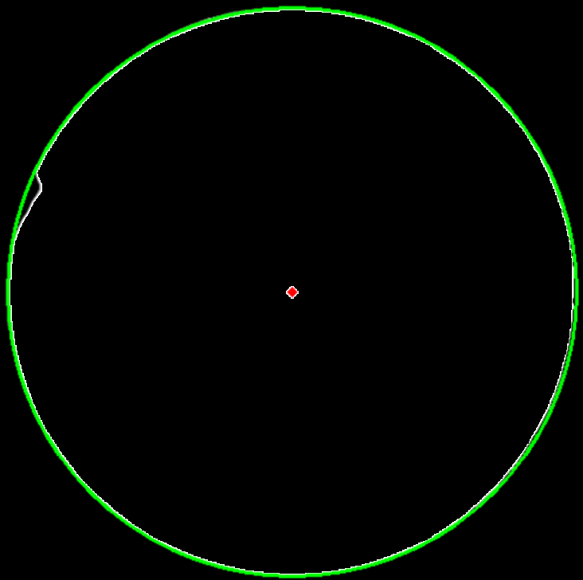
Noise Removal
Method
Thresholding using Median Filter
Final Image for Calculations

Slide 7
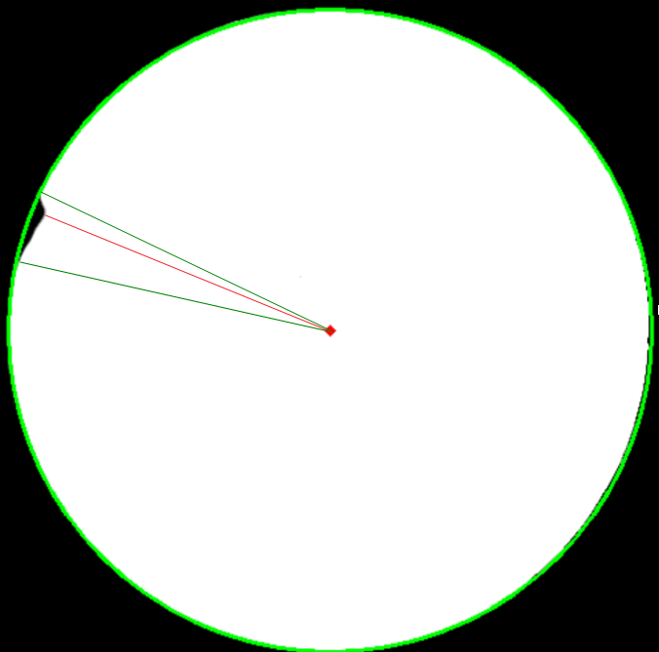
Detection of Edge Vertices
Method
(i)Thresholding

Slide 8
Calculation of Edge Attributes
Attributes:
(i)Number of Edge Chips
(ii)Maximum Depth of each chip
(iii)Area of each chip
(iv)% of circumference of each chip

Slide 9

Reference
https://github.com/Alma-hanif/BESTFAUlts.git

Slide 10


Thank you

Slide 11




Questions?
Susmitha
Alma
Roberto
Shiva

